Slide 1
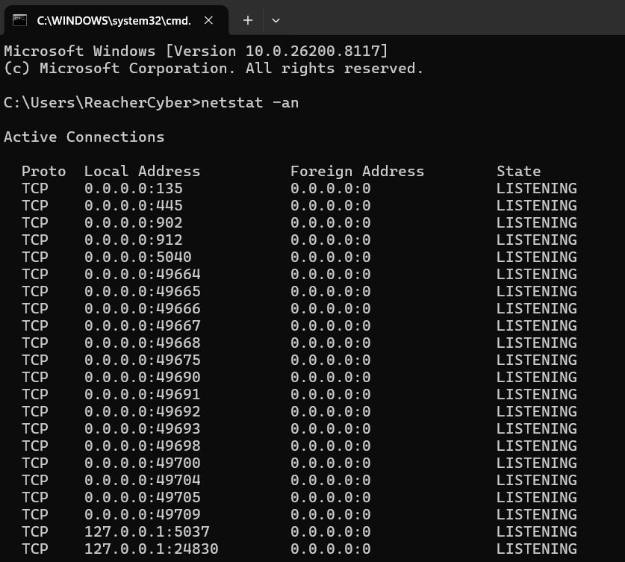
netstat –an : All connections

Slide 2
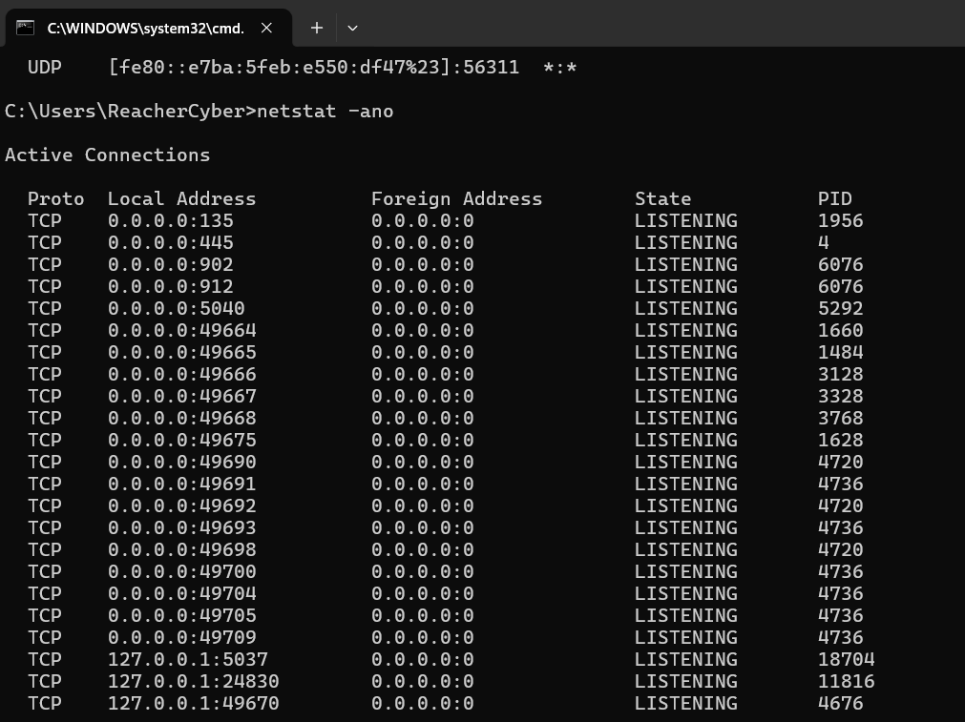
netstat –ano : all connections with PID

Slide 3
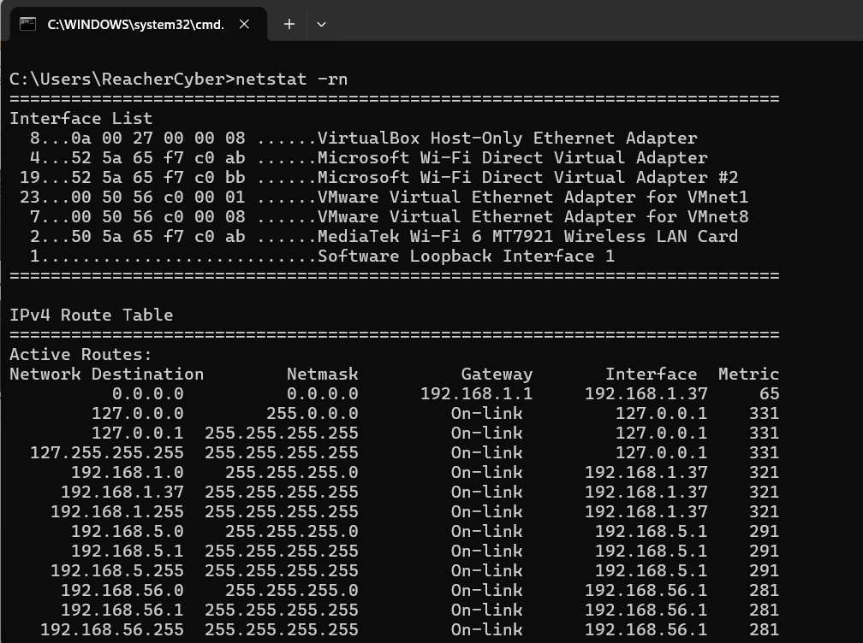
netstat –rn : routing table

